Slide 1
String-Immutable
Mutable String-
StringBuffer/ StringBuilder

Slide 2
String
String objects are handled specially by the compiler.
String is the only class which has "implicit" instantiation.
The String class is defined in the java.lang package.
String newString = new String(stringLiteral);
String message = new String("Welcome to Java");
String message = "Welcome to Java";
Strings are immutable. The value of a String object can never be changed.
For mutable Strings, use the StringBuffer class

Slide 3
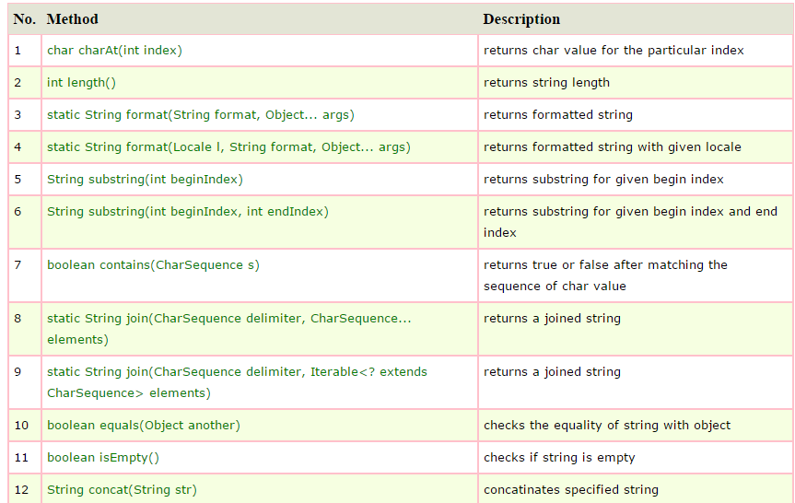
The String Class

Slide 4
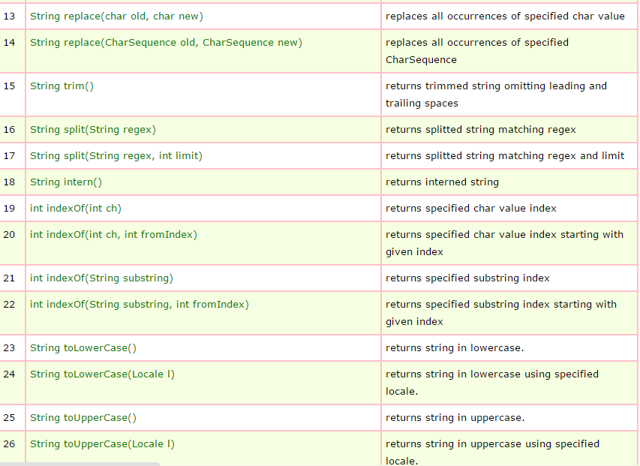

Slide 5
Strings Are Immutable
A String object is immutable; its contents cannot be changed. Does the following code change the contents of the string?
String s = "Java";
s = "HTML";

Slide 6
Strings are Immutable
Immutable- Strings and other objects that can’t be changed
  String is a class; each created String is a class object
  Strings are never actually changed; instead new Strings are created and String variables hold the new addresses.
  A part of the Java system called the garbage collector will eventually discard the unused strings
So, what does this mean for Java programmers?

Slide 7

Trace Code
String s = "Java";
s = "HTML";

Slide 8
Trace Code
animation
String s = "Java";
s = "HTML";

Slide 9
Finding String Length
Finding string length using the length() method:
message = "Welcome";
message.length() (returns 7)

Slide 10
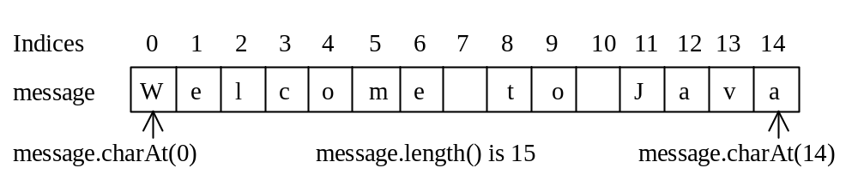
Retrieving Individual Characters in a String
Do not use message[0]
Use message.charAt(index)
Index starts from 0

Slide 11
String Concatenation
String s3 = s1.concat(s2);
String s3 = s1 + s2;
s1 + s2 + s3 + s4 + s5 same as
(((s1.concat(s2)).concat(s3)).concat(s4)).concat(s5);

Slide 12
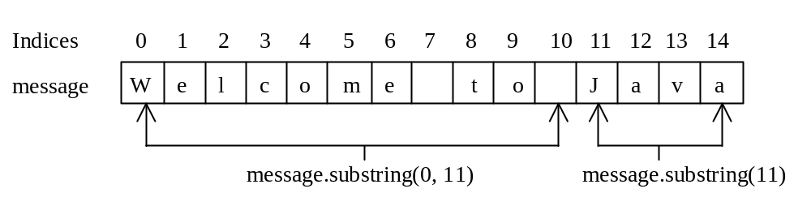
Extracting Substrings
You can extract a single character from a string using the charAt method. You can also extract a substring from a string using the substring method in the String class.
String s1 = "Welcome to Java";
String s2 = s1.substring(0, 11) + “OOAD";

Slide 13
Comparing String Values
Because String variables hold memory addresses, you cannot make a simple comparison
The String class provides a number of methods
  equals() method
  equalsIgnoreCase() method
  compareTo() method

Slide 14
String Comparisons
equals
String s1 = new String("Welcome“);
String s2 = "welcome";
if (s1.equals(s2)){
// s1 and s2 have the same contents
}
if (s1 == s2) {
// s1 and s2 have the same reference
}

Slide 15
String Comparisons, cont.
compareTo(Object object)
String s1 = new String("Welcome“);
String s2 = "welcome";
if (s1.compareTo(s2) > 0) {
// s1 is greater than s2
}
else if (s1.compareTo(s2) == 0) {
// s1 and s2 have the same contents
}
else
// s1 is less than s2

Slide 16
String Conversions
The contents of a string cannot be changed once the string is created. But you can convert a string to a new string using the following methods:
toLowerCase
toUpperCase
trim
replace(oldChar, newChar)

Slide 17
Finding a Character or a Substring in a String
"Welcome to Java".indexOf('W') returns 0.
"Welcome to Java".indexOf('x') returns -1.
"Welcome to Java".indexOf('o', 5) returns 9.
"Welcome to Java".indexOf("come") returns 3.
"Welcome to Java".indexOf("Java", 5) returns 11.
"Welcome to Java".indexOf("java", 5) returns -1.
"Welcome to Java".lastIndexOf('a') returns 14.

Slide 18
Convert Character and Numbers to Strings
The String class provides several static valueOf methods for converting a character, an array of characters, and numeric values to strings. These methods have the same name valueOf with different argument types char, char[], double, long, int, and float. For example, to convert a double value to a string, use String.valueOf(5.44). The return value is string consists of characters ‘5’, ‘.’, ‘4’, and ‘4’.

Slide 19
Learning about the StringBuffer Class
A String class limitation is that the value of a String is fixed after the string is created
To circumvent these limitations you can use the StringBuffer class

Slide 20
StringBuffer
StringBuffer is an alternative to the String class
Part of the java.lang package
Must use the keyword new and provide an initializing value between parentheses
A StringBuffer object contains a memory block called a buffer which might not contain a string

Slide 21
StringBuffer
The length of the String may not be the same as the length of the buffer
The length of the buffer is referred to as the capacity of the StringBuffer object
You can change the length of a String in a StringBuffer object with the setLength() method
When the StringBuffer object’s length is longer than the String it holds, the extra characters contain ‘\u0000’
If you use the setLength() method to specify a length shorter than its String, the string is truncated

Slide 22
StringBuilder and StringBuffer
The StringBuilder/StringBuffer class is an alternative to the String class. In general, a StringBuilder/StringBuffer can be used wherever a string is used. StringBuilder/StringBuffer is more flexible than String. You can add, insert, or append new contents into a string buffer, whereas the value of a String object is fixed once the string is created.

Slide 23
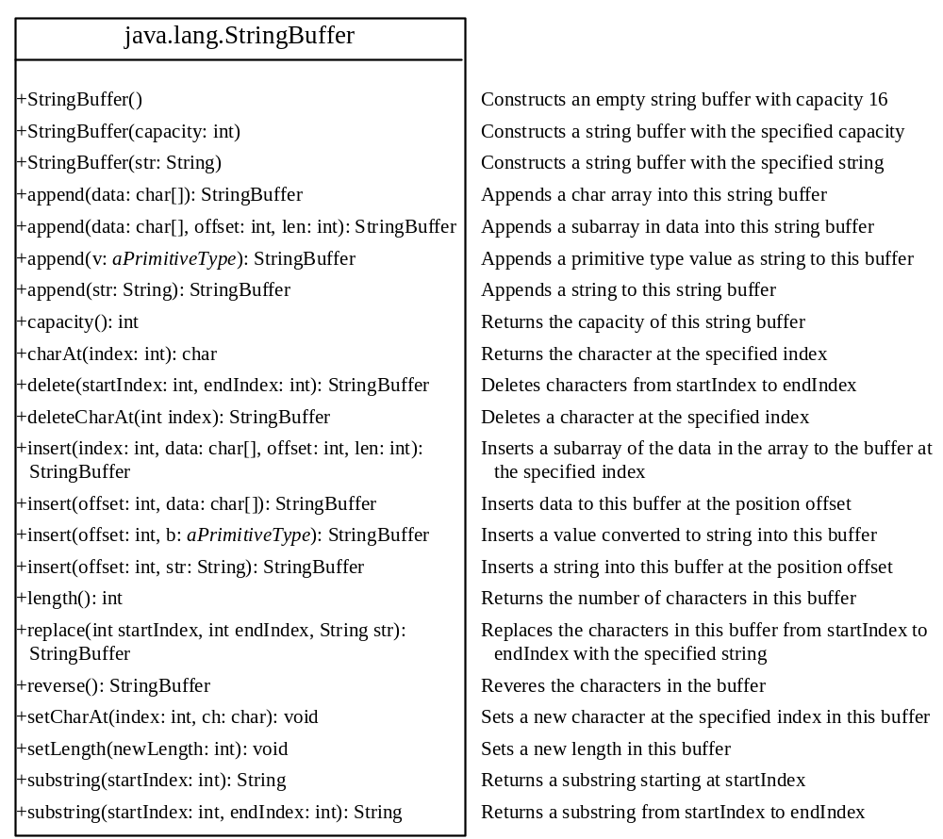

Slide 24
StringBuffer Constructors
public StringBuffer()
No characters, initial capacity 16 characters.
public StringBuffer(int length)
No characters, initial capacity specified by the length argument.
public StringBuffer(String str)
Represents the same sequence of characters
as the string argument. Initial capacity 16
plus the length of the string argument.

Slide 25
length( ) and capacity( )
// StringBuffer length vs. capacity.
class StringBufferDemo {
public static void main(String args[]) {
StringBuffer sb = new StringBuffer("Hello");
System.out.println("buffer = " + sb);
System.out.println("length = " + sb.length());
System.out.println("capacity = " + sb.capacity());
}
}
Output:-
buffer = Hello
length = 5
capacity = 21

Slide 26
// Demonstrate charAt() and setCharAt().
class setCharAtDemo {
public static void main(String args[]) {
StringBuffer sb = new StringBuffer("Hello");
System.out.println("buffer before = " + sb);
System.out.println("charAt(1) before = " + sb.charAt(1));
sb.setCharAt(1, 'i');
sb.setLength(2);
System.out.println("buffer after = " + sb);
System.out.println("charAt(1) after = " + sb.charAt(1));
}
}
Output:-
buffer before = Hello
charAt(1) before = e
buffer after = Hi
charAt(1) after = i

Slide 27
delete( ) and deleteCharAt( )
Java 2 added to StringBuffer the ability to delete characters using the methods
delete( ) and deleteCharAt( ). These methods are shown here:
StringBuffer delete(int startIndex, int endIndex)
StringBuffer deleteCharAt(int loc)
The delete( ) method deletes a sequence of characters from the invoking object.
Here, startIndex specifies the index of the first character to remove, and endIndex
specifies an index one past the last character to remove. Thus, the substring deleted
runs from startIndex to endIndex–1. The resulting StringBuffer object is returned.
The deleteCharAt( ) method deletes the character at the index specified by loc.
It returns the resulting StringBuffer object.

Slide 28
Appending New Contents into a String Buffer
StringBuffer strBuf = new StringBuffer();
strBuf.append("Welcome");
strBuf.append(' ');
strBuf.append("to");
strBuf.append(' ');
strBuf.append("Java");

Slide 29
// Demonstrate delete() and deleteCharAt()
class deleteDemo {
public static void main(String args[]) {
StringBuffer sb = new StringBuffer("This is a test.");
sb.delete(4, 7);
System.out.println("After delete: " + sb);
sb.deleteCharAt(0);
System.out.println("After deleteCharAt: " + sb);
}
}
Output:-
After delete: This a test.
After deleteCharAt: his a test.

Slide 30
replace( )
Another method added to StringBuffer by Java 2 is replace( ). It replaces one set of
characters with another set inside a StringBuffer object. Its signature is shown here:
StringBuffer replace(int startIndex, int endIndex, String str)
The substring being replaced is specified by the indexes startIndex and endIndex. Thus,
the substring at startIndex through endIndex–1 is replaced. The replacement string is
passed in str. The resulting StringBuffer object is returned.

Slide 31
// Demonstrate replace()
class replaceDemo {
public static void main(String args[]) {
StringBuffer sb = new StringBuffer("This is a test.");
sb.replace(5, 7, "was");
System.out.println("After replace: " + sb);
}
}
output:
After replace: This was a test.

Slide 32
StringTokenizer
Used to break up a string based on a certain “token”
  e.g. take the string “Homer, Marge, Bart, Lisa, Maggie”
  You can use the StringTokenizer to break up the string based
  on the comma to get five separate strings
  “Homer” “Marge” “Bart” “Lisa” and “Maggie”
Easier than using the “if” statement
Example:
  String testString = “one-two-three”;
  StringTokenizer st = new StringTokenizer(testString,”-");
  while (st.hasMoreTokens()) {
  String nextName = st.nextToken();
  System.out.println(nextName);
  }
  Result:
  one
  two
  three

Slide 33
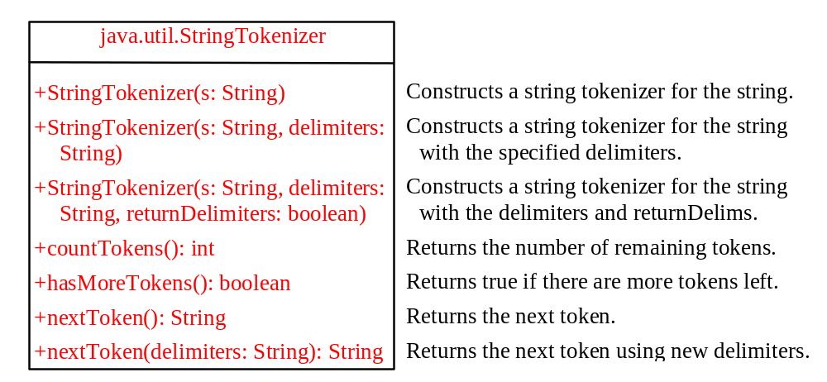
The StringTokenizer Class

Slide 34
Examples 1
  String s = "Java is cool.";
  StringTokenizer tokenizer = new StringTokenizer(s);
  System.out.println("The total number of tokens is " +
  tokenizer.countTokens());
  while (tokenizer.hasMoreTokens())
  System.out.println(tokenizer.nextToken());
The code displays
    The total number of tokens is 3
    Java
    is
    cool.

Slide 35
Examples 2
  String s = "Java is cool.";
  StringTokenizer tokenizer = new StringTokenizer(s, "ac");
  System.out.println("The total number of tokens is " +
  tokenizer.countTokens());
  while (tokenizer.hasMoreTokens())
  System.out.println(tokenizer.nextToken());
The code displays
    The total number of tokens is 4
    J
    v
    is
    ool.

Slide 36
Examples 3
  String s = "Java is cool.";
  StringTokenizer tokenizer = new StringTokenizer(s, "ac", true);
  System.out.println("The total number of tokens is " +
  tokenizer.countTokens());
  while (tokenizer.hasMoreTokens())
  System.out.println(tokenizer.nextToken());
The code displays
    The total number of tokens is 7
    J
    a
    v
    a
    is
    c
    ool.

Slide 37
No no-arg Constructor in StringTokenizer
The StringTokenizer class does not have a no-arg constructor. Normally it is a good programming practice to provide a no-arg constructor for each class. On rare occasions, however, a no-arg constructor does not make sense. StringTokenizer is such an example. A StringTokenizer object must be created for a string, which should be passed as an argument from a constructor.

